Slide 1

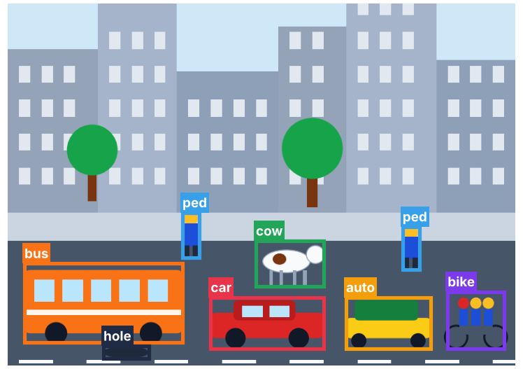
Research Frontiers in Computer Vision
Welcome and Session Introduction
Dr. Jyoti Dabass

Slide 2
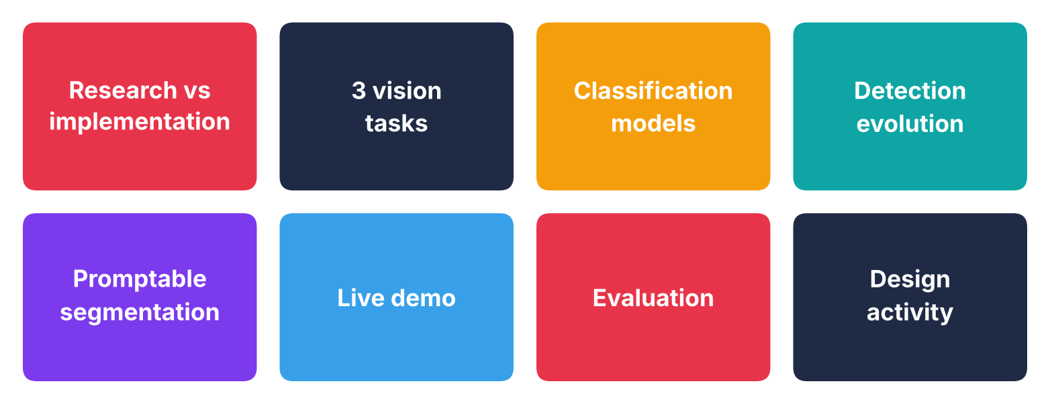
Today's Agenda and What You Will Learn
Leave knowing what you can investigate and prove

Slide 3
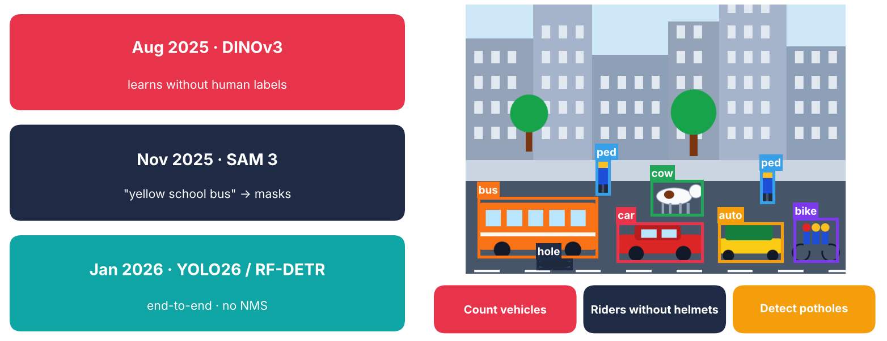
Why Now, and Our Running Case
Same cameras · three needs · three different tasks

Slide 4
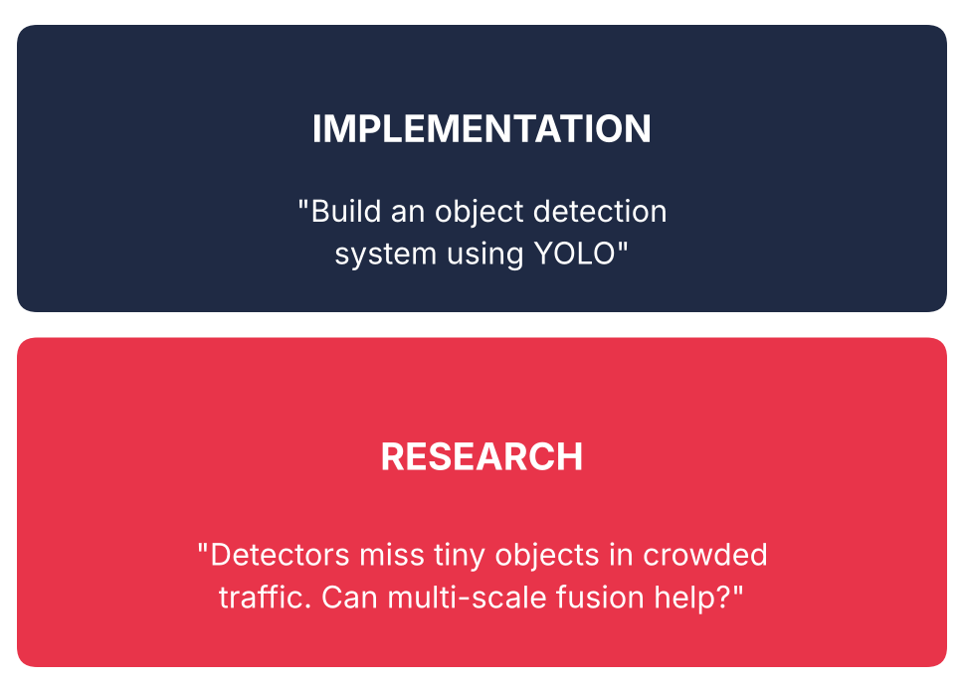
Frontier Map: Implementation or Research?
Vote in chat: Implementation or Research
Implementation = what to build
Research = problem and test

Slide 5
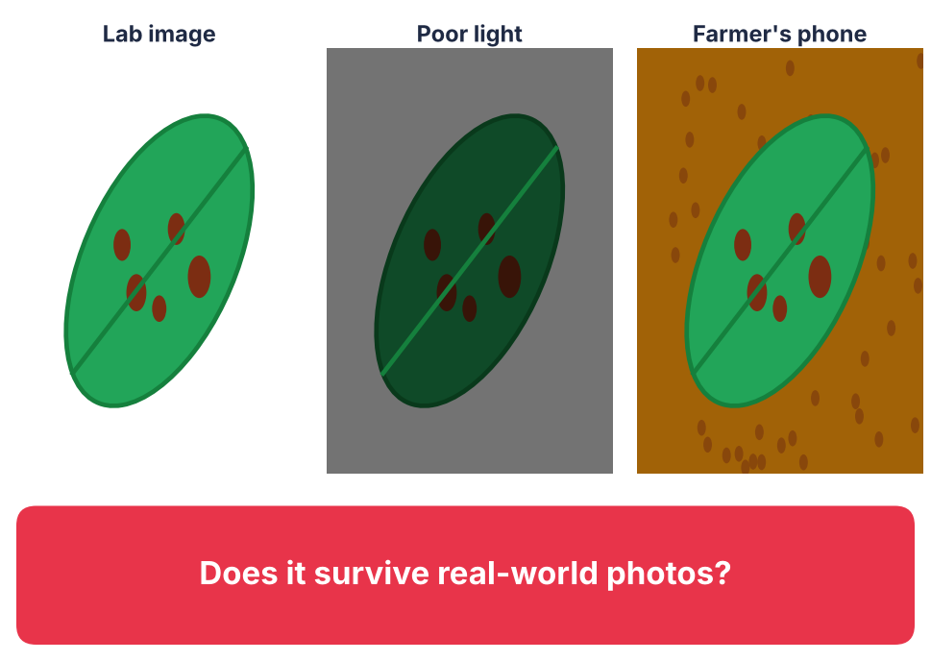
Project Statement 1: Image Classification
Residual Network for plant diseases
Poor light? Early stage? Field photo?
IMPLEMENTATION

Slide 6
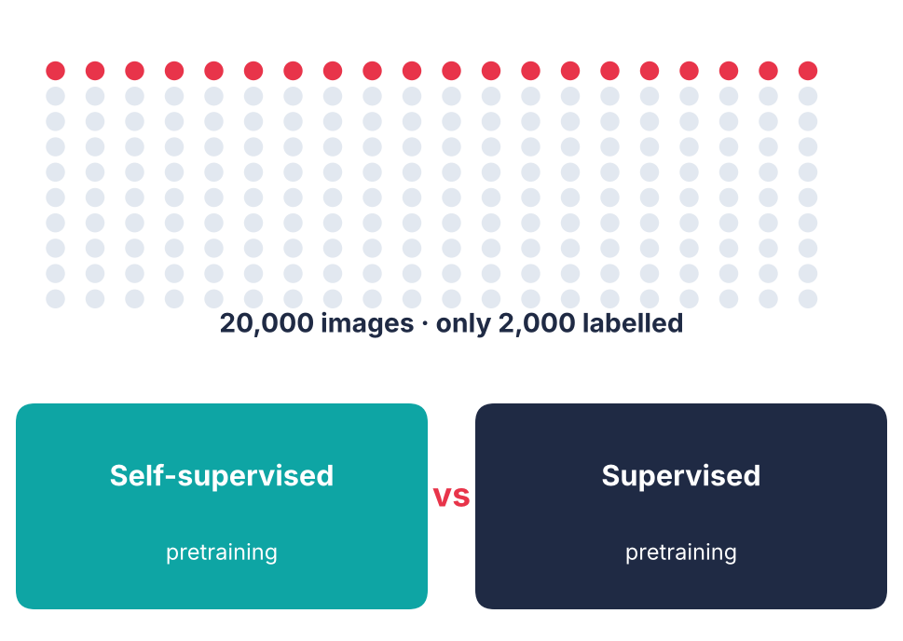
Project Statement 2: Self-Supervised Learning
Self-supervised versus supervised, few labels
Specific problem and baseline
RESEARCH

Slide 7
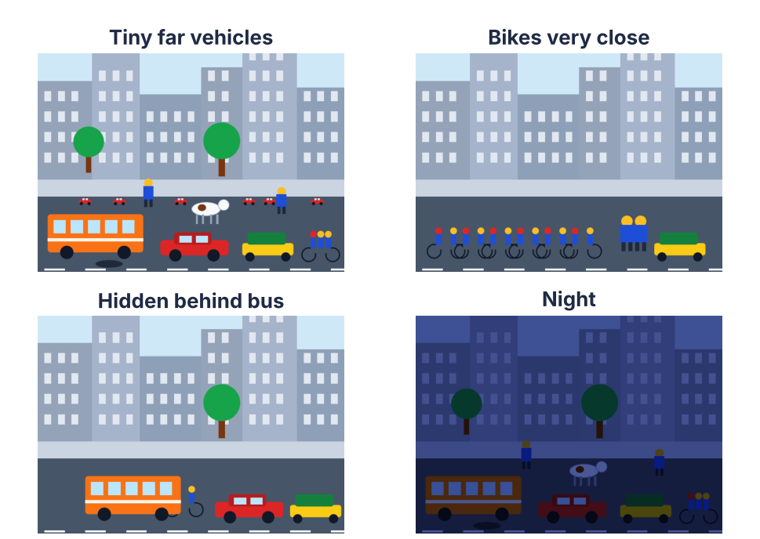
Project Statement 3: Object Detection
You Only Look Once to detect vehicles
No limitation identified
IMPLEMENTATION

Slide 8
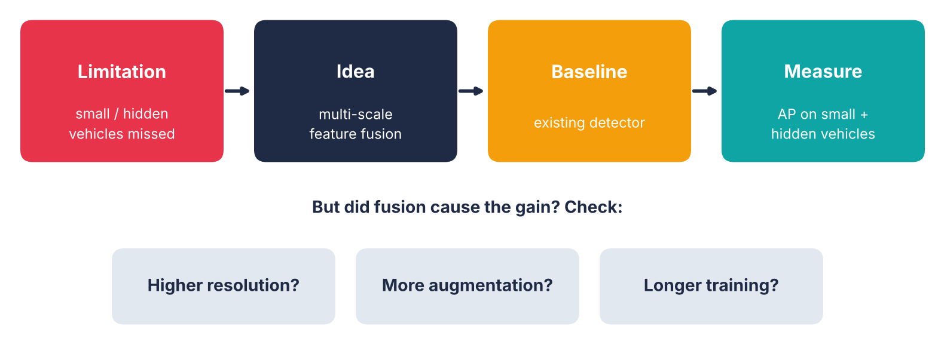
Project Statement 4: Improving Small Object Detection
RESEARCH: fair comparison, same conditions

Slide 9
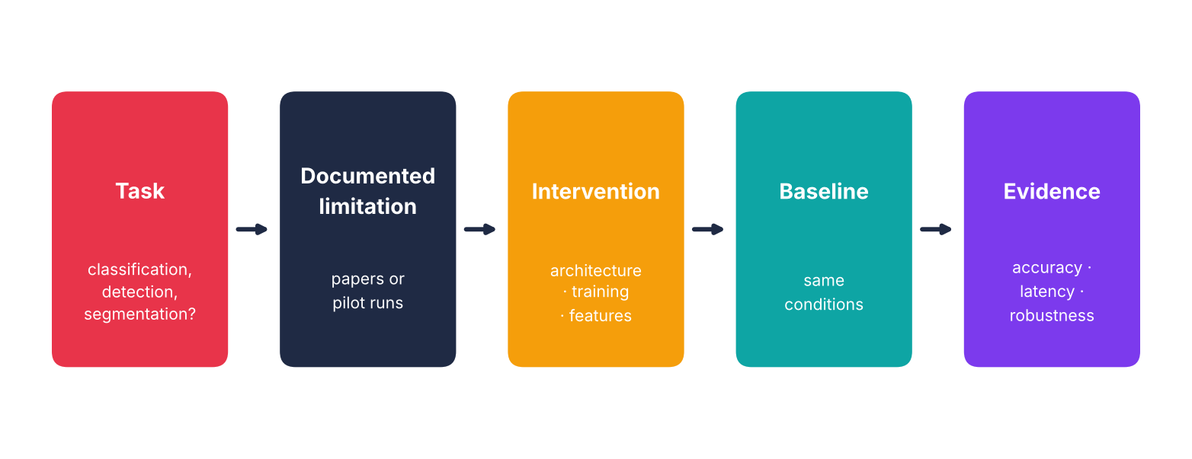
Five Elements of a Testable Research Question
Check all five before making a claim

Slide 10
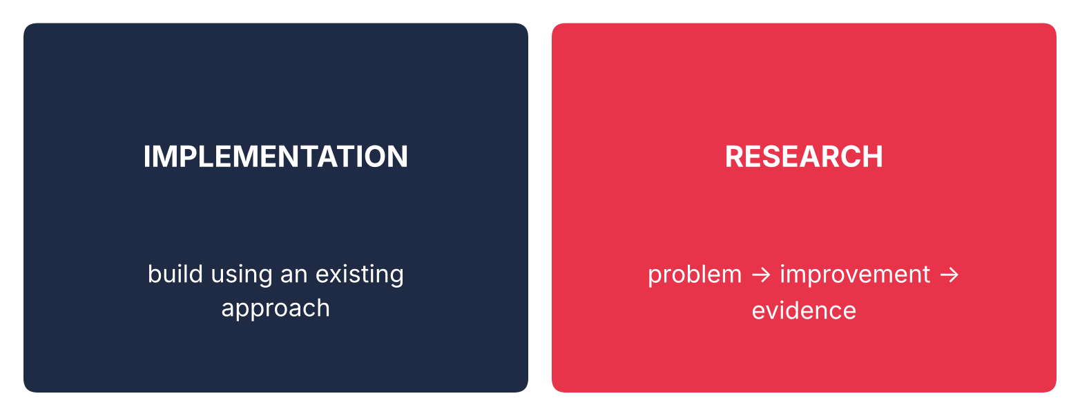
From Implementation to Research
What result would convince me my idea does NOT work?

Slide 11
Quick Check
A project says: “Build a vehicle detector using You Only Look Once.” What is still missing for it to become research?
A A newer model
B A documented limitation and testable hypothesis
C More training images
D Higher accuracy

Slide 12
Answer
A project says: “Build a vehicle detector using You Only Look Once.” What is still missing for it to become research?
A A newer model
✓ B A documented limitation and testable hypothesis
C More training images
D Higher accuracy
Why: Research needs a limitation, an intervention, a baseline and evidence.

Slide 13
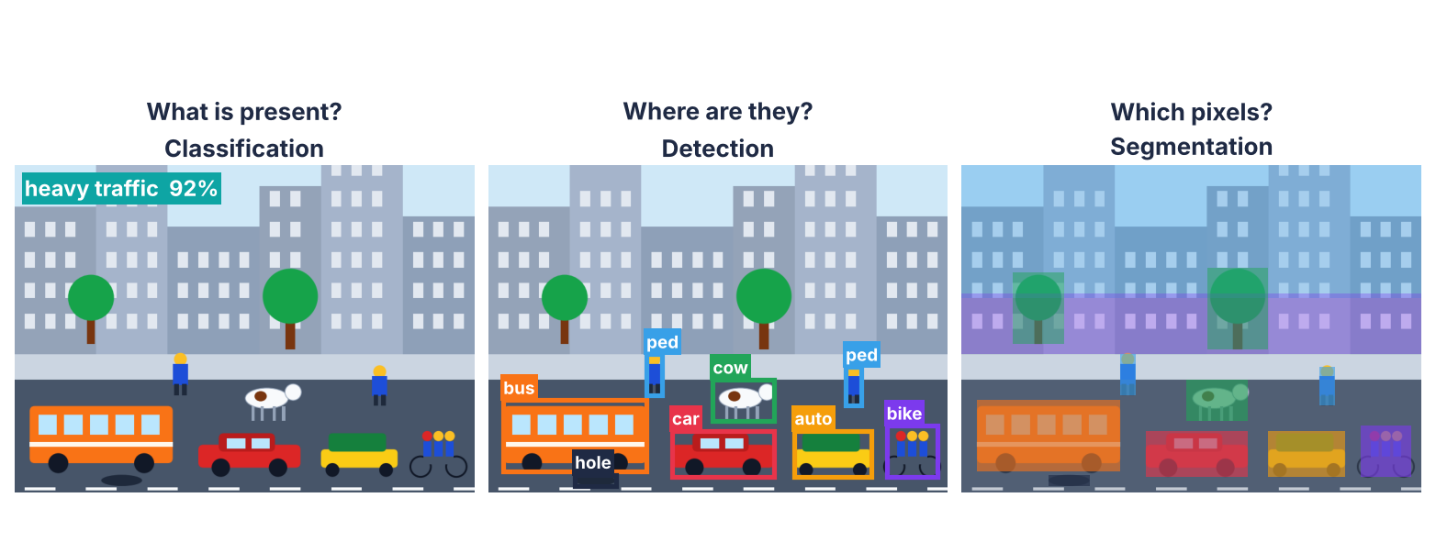
The Vision Task Landscape
One image · three different questions

Slide 14
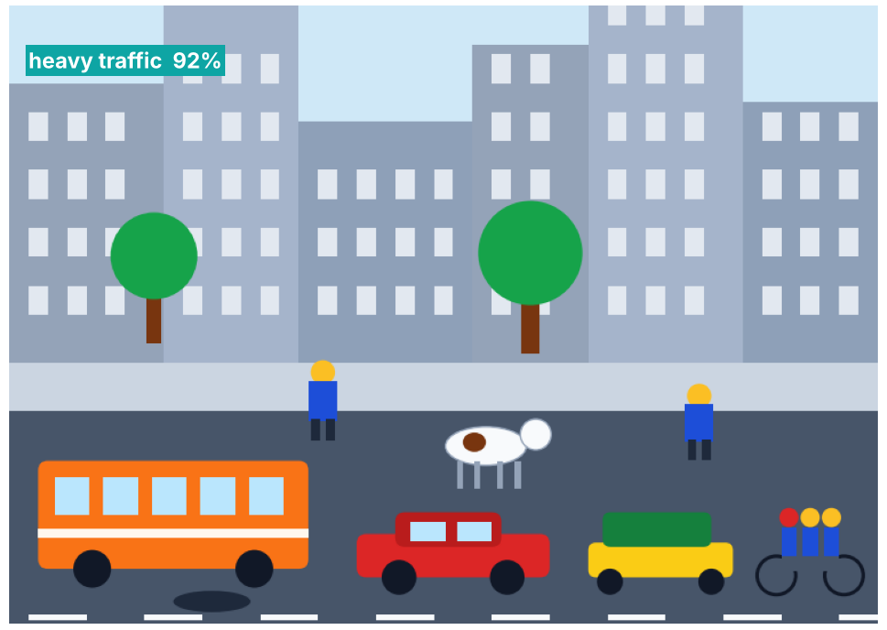
Image Classification: What Is in the Image?
Output: label and confidence
Label: image-level
Loss: cross-entropy

Slide 15
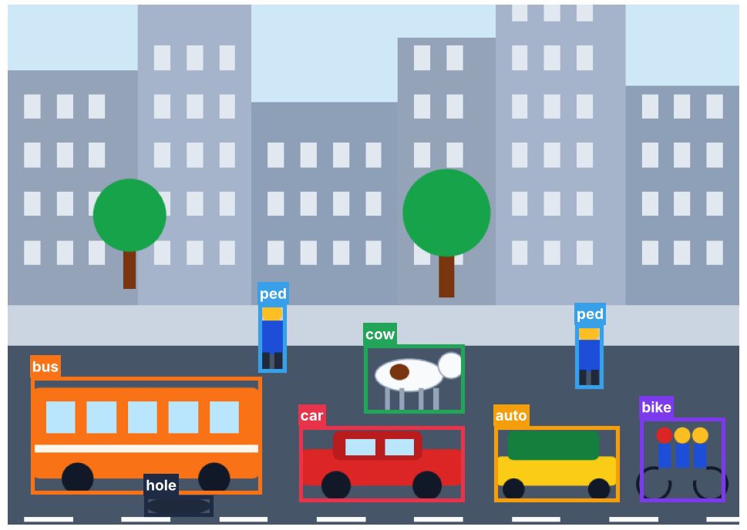
Object Detection: Where Are the Objects?
Output: class and box
Label: box coordinates
Loss: class and box regression

Slide 16
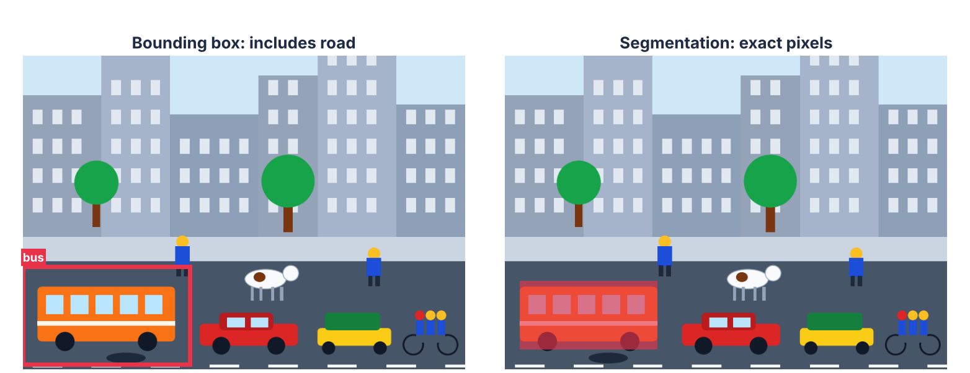
Image Segmentation: Which Pixels Belong to the Object?
Need exact boundaries? Use segmentation

Slide 17
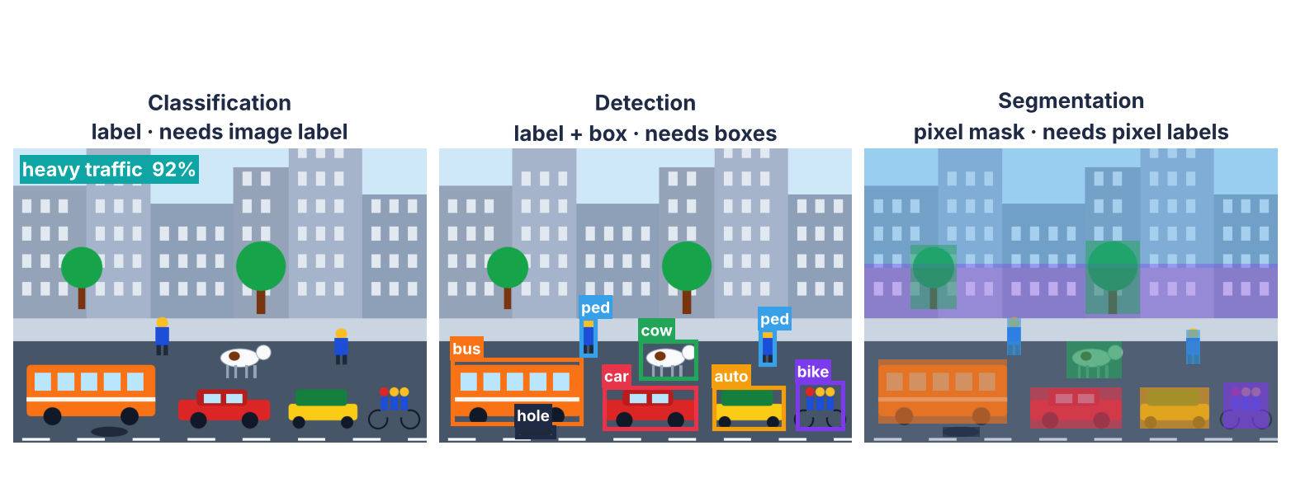
Classification versus Detection versus Segmentation
More detail is not the same as better research

Slide 18
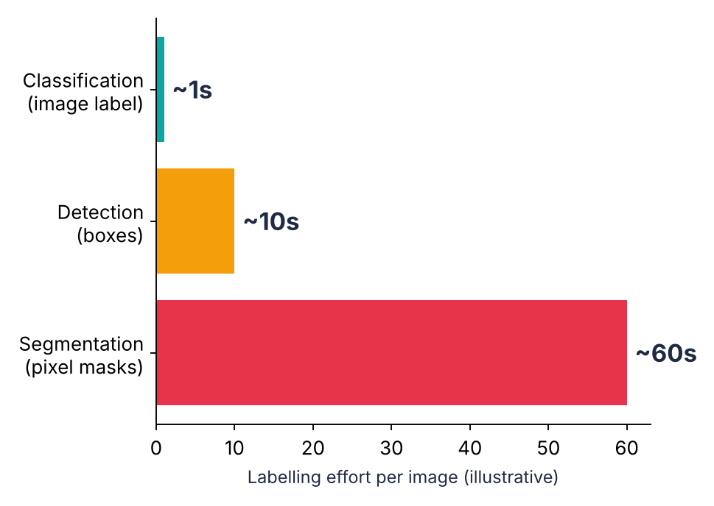
Annotation Cost: How Much Labelling Is Required?
10,000 traffic images
Overlaps and hidden pedestrians
Is the labelling realistic?

Slide 19
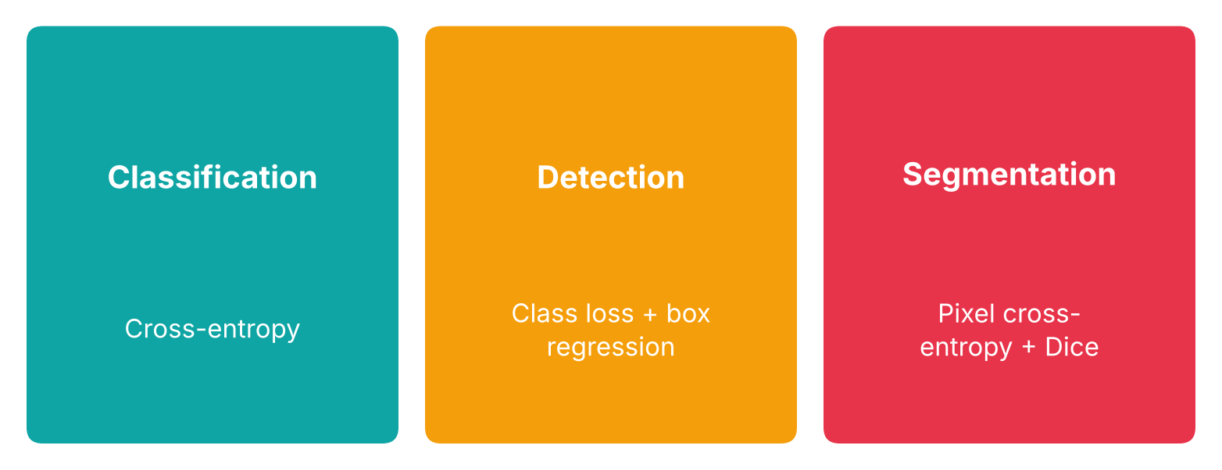
Loss Functions: What Does the Model Learn to Minimize?
Loss depends on what the model predicts

Slide 20
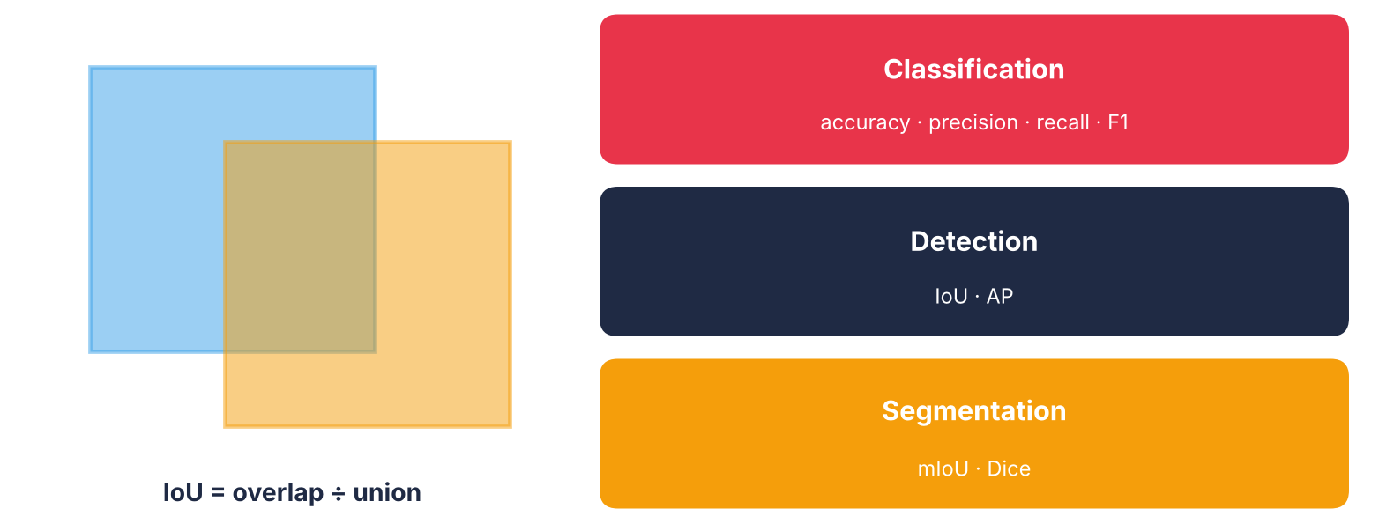
Evaluation Metrics: How Do We Measure Performance?
The metric must match output and purpose

Slide 21
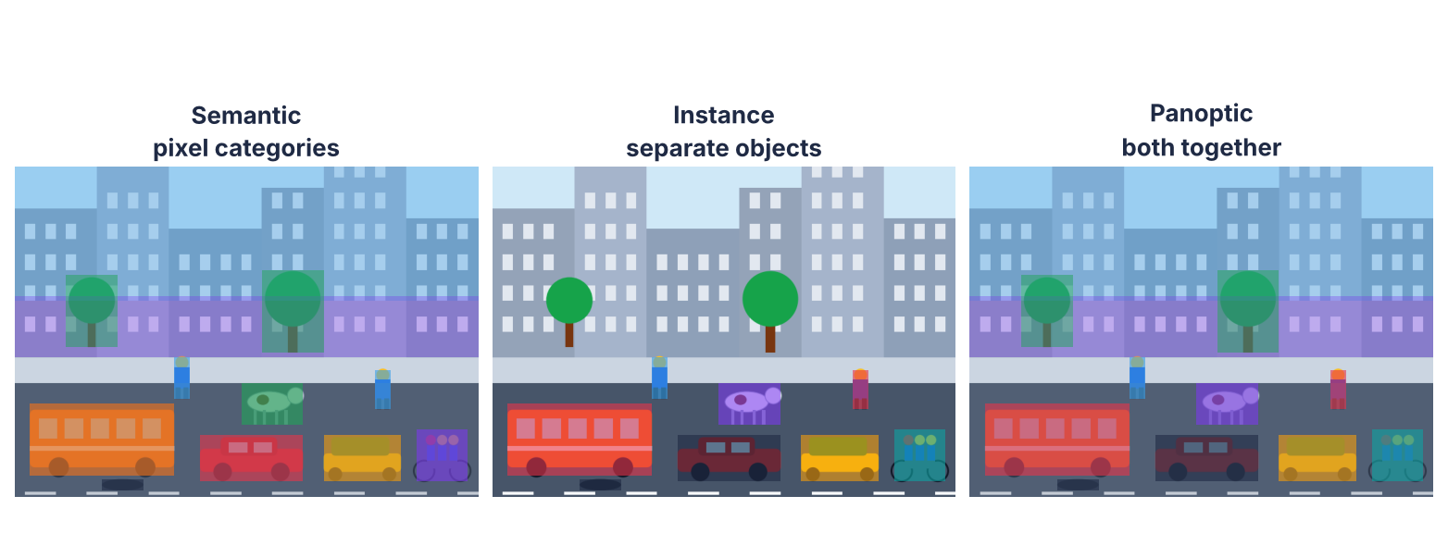
Understanding Segmentation: Three Different Types
Same scene · three different outputs

Slide 22
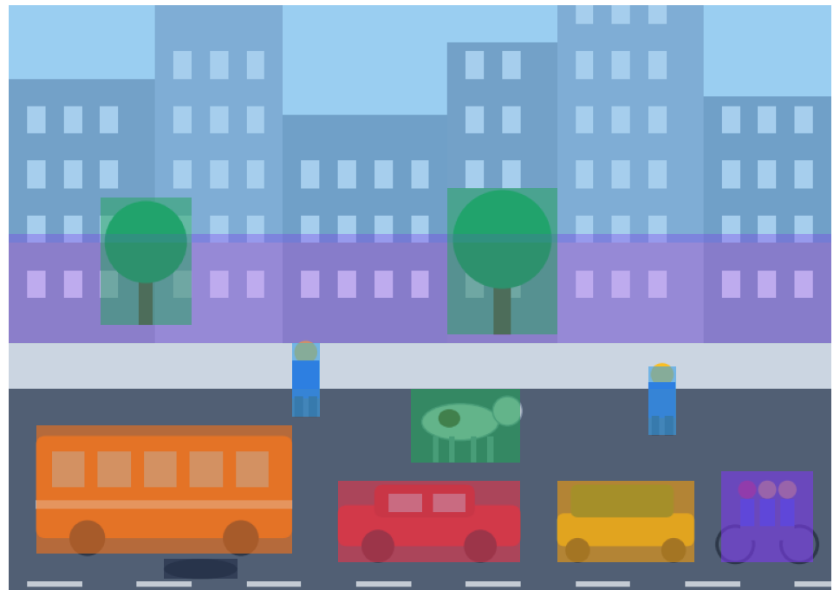
Semantic Segmentation: What Does Each Pixel Represent?
Every pixel gets a class
5 cars = one “vehicle” region
Road-scene understanding

Slide 23
Quick Check
Five cars appear in an image. What does semantic segmentation produce?
A A separate mask for every car
B All car pixels labelled “vehicle”, cars not separated
C One bounding box per car
D Only “heavy traffic”

Slide 24
Answer
Five cars appear in an image. What does semantic segmentation produce?
A A separate mask for every car
✓ B All car pixels labelled “vehicle”, cars not separated
C One bounding box per car
D Only “heavy traffic”
Why: Instance segmentation would separate the cars; panoptic segmentation gives both.

Slide 25
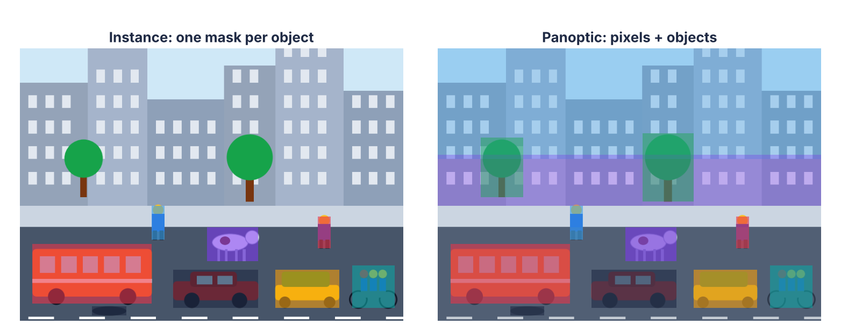
Instance and Panoptic Segmentation
Semantic: what · Instance: which · Panoptic: both

Slide 26
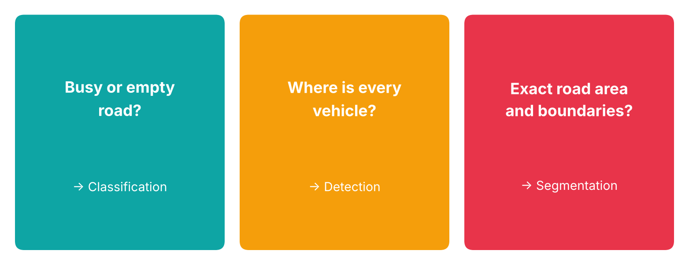
How Task Selection Changes Research Design
High classification accuracy is not the same as located vehicles

Slide 27
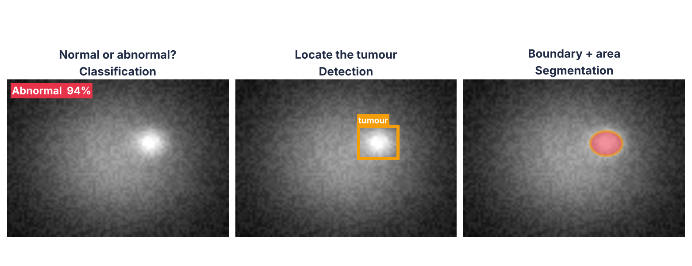
Choosing the Right Task for Your Research
Start from the application requirement

Slide 28
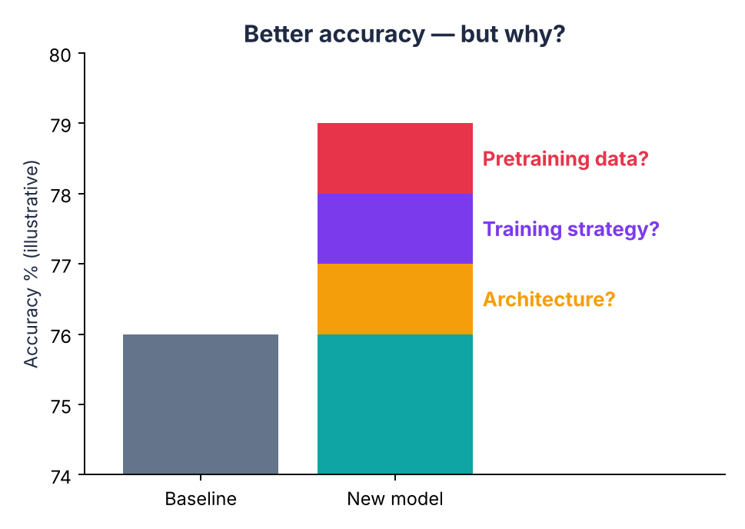
Classification Frontiers: What Makes a Model Perform Better?
Architecture?
Training strategy?
Pretraining data?

Slide 29
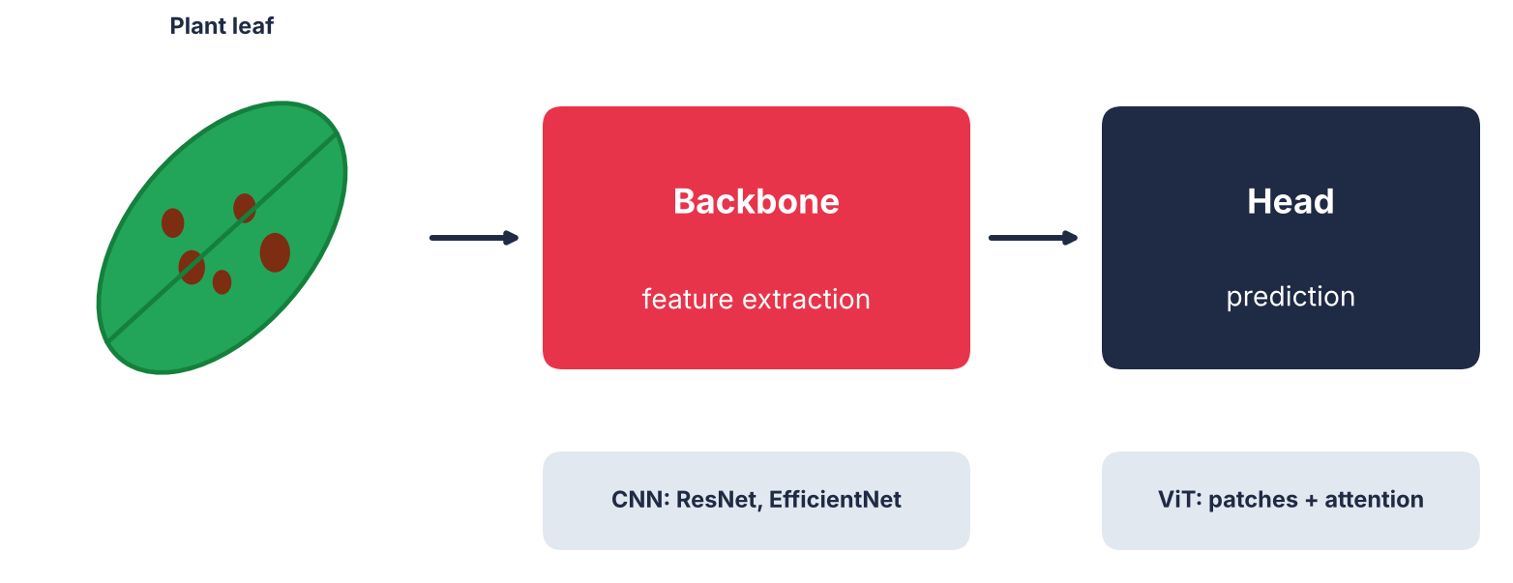
What Is a Backbone in Computer Vision?
Backbone = the feature extractor

Slide 30
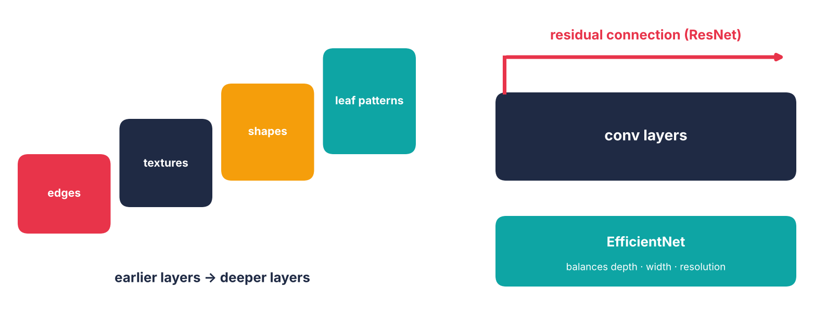
Convolutional Neural Network Backbones: Learning Visual Features
Residual Network · EfficientNet

Slide 31
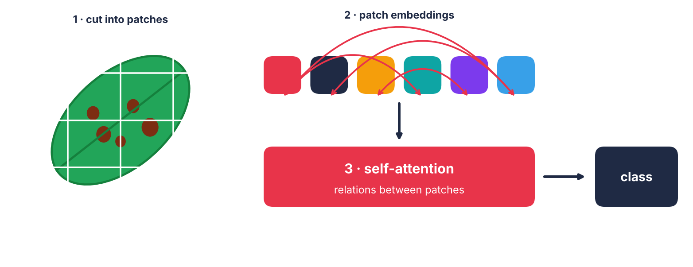
Vision Transformers: A Different Way to Process Images
Compare fairly, not “newer versus older”

Slide 32
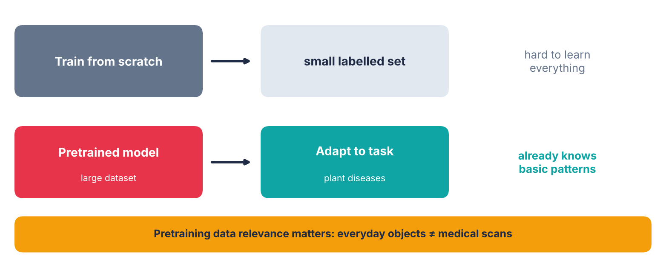
What Is Pretraining and Why Does It Matter?
Reuse visual knowledge from larger data

Slide 33
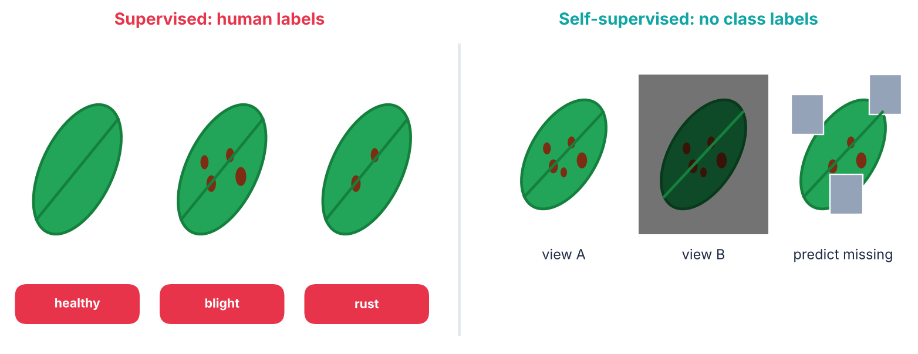
Supervised versus Self-Supervised Pretraining
Self-supervised: learn from the images themselves

Slide 34
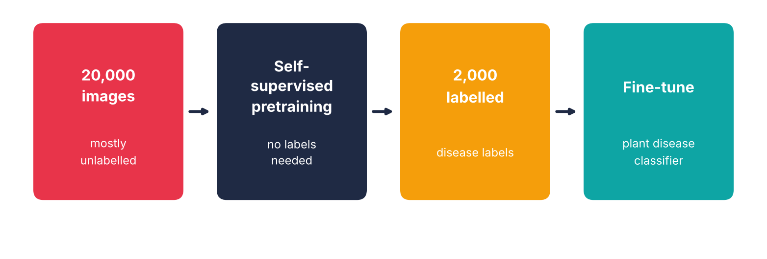
Self-Supervised Learning: Learning Without Manual Labels
Test it: it may help, change little, or hurt

Slide 35
Quick Check
You have 20,000 plant images but only 2,000 labels. Which approach uses all 20,000?
A Train from scratch on 2,000
B Self-supervised pretraining, then fine-tune on 2,000
C Skip the baseline
D Test on the training set

Slide 36
Answer
You have 20,000 plant images but only 2,000 labels. Which approach uses all 20,000?
A Train from scratch on 2,000
✓ B Self-supervised pretraining, then fine-tune on 2,000
C Skip the baseline
D Test on the training set
Why: Self-supervised learning uses unlabelled images before fine-tuning.

Slide 37
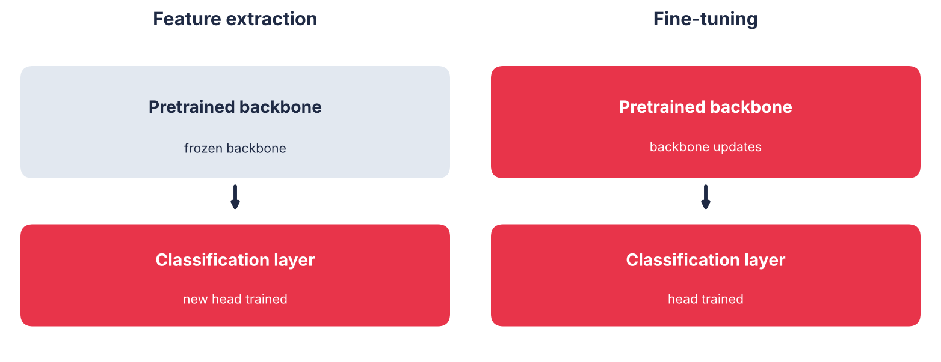
Transfer Learning: Adapting a Pretrained Model
Choice depends on data, domain and resources

Slide 38
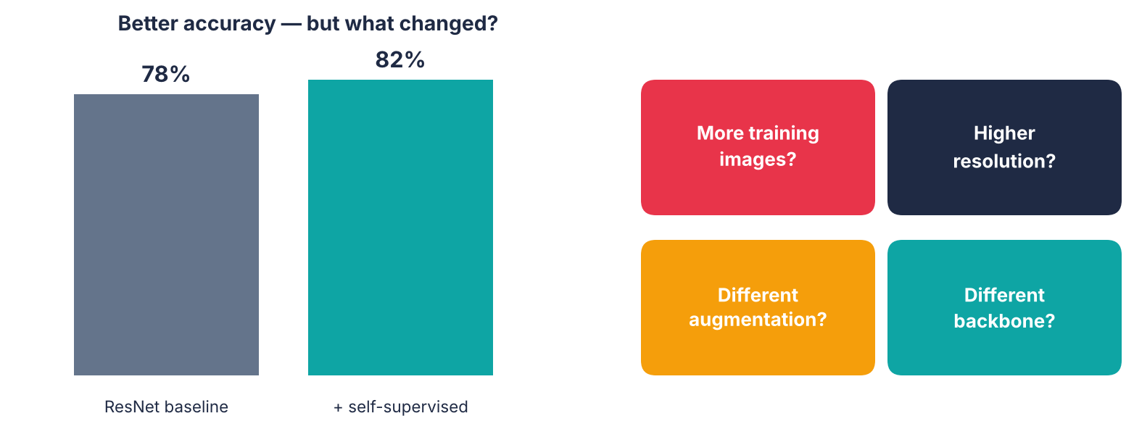
Research Case: Where Does the Performance Improvement Come From?
Better accuracy needs an explanation

Slide 39
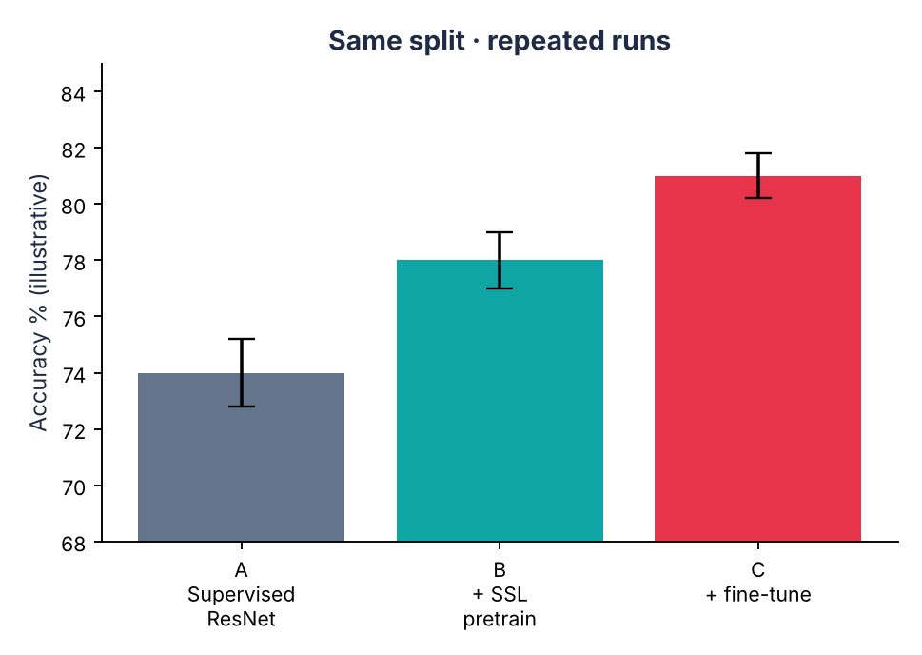
Ablation Study: Testing What Actually Helps
Same split and conditions
Check repeated runs
Per-class results and compute

Slide 40
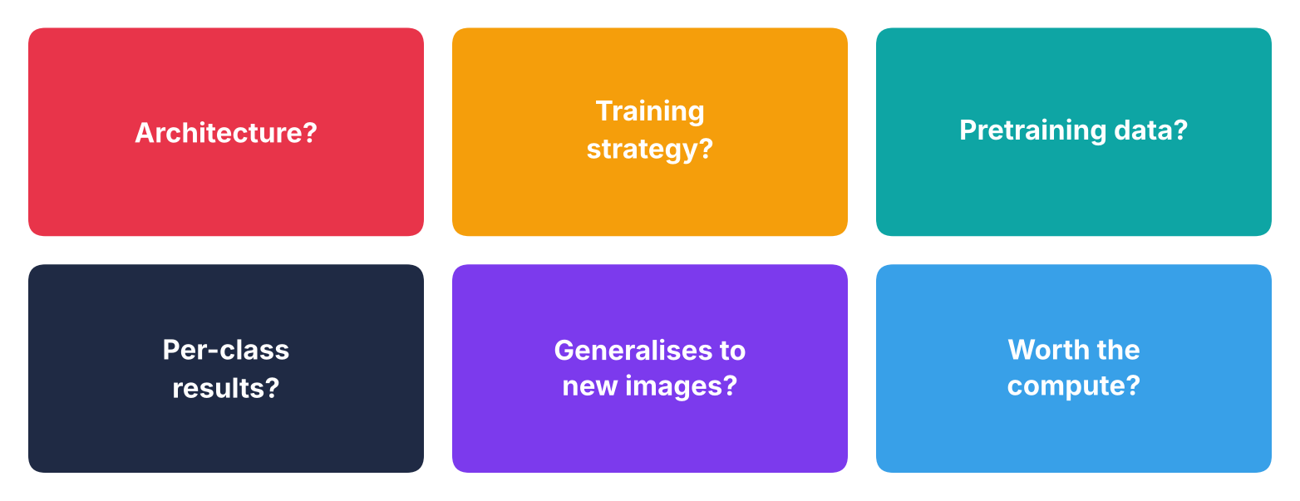
What Should We Conclude From a Model Comparison?
Look beyond the final accuracy number

Slide 41
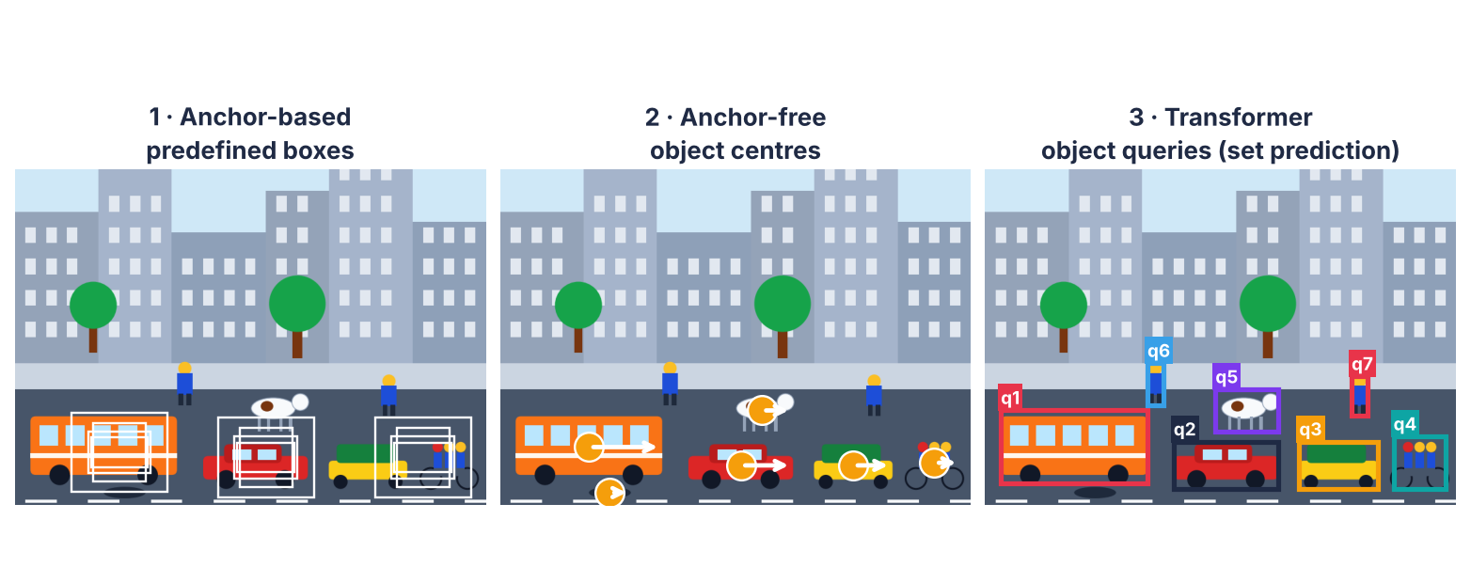
Detection Frontiers: How Have Object Detectors Evolved?
Anchors → Anchor-free → Set prediction

Slide 42
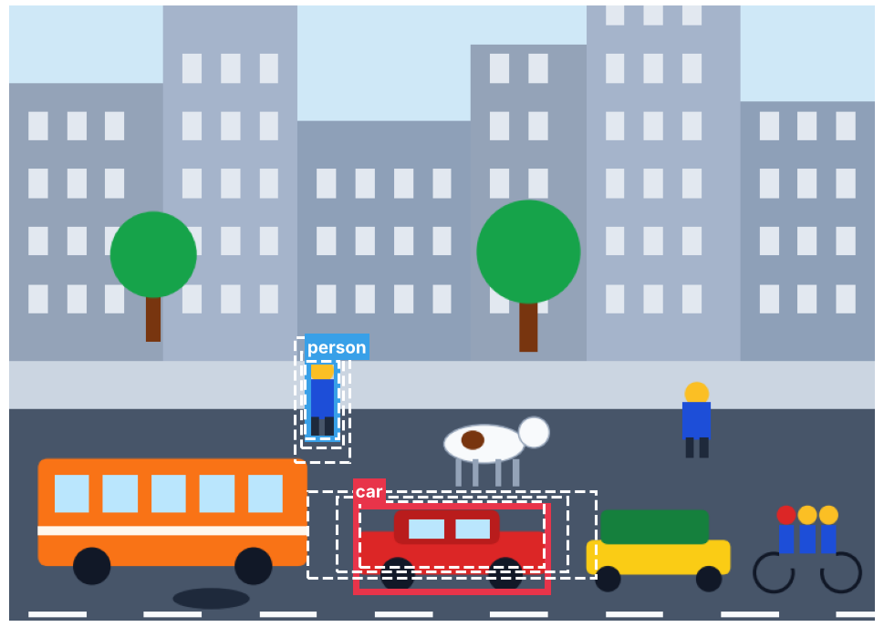
Anchor-Based Detection: Starting with Predefined Boxes
Predefined boxes
Different sizes and aspect ratios
Example: Faster Region-based Convolutional Neural Network

Slide 43
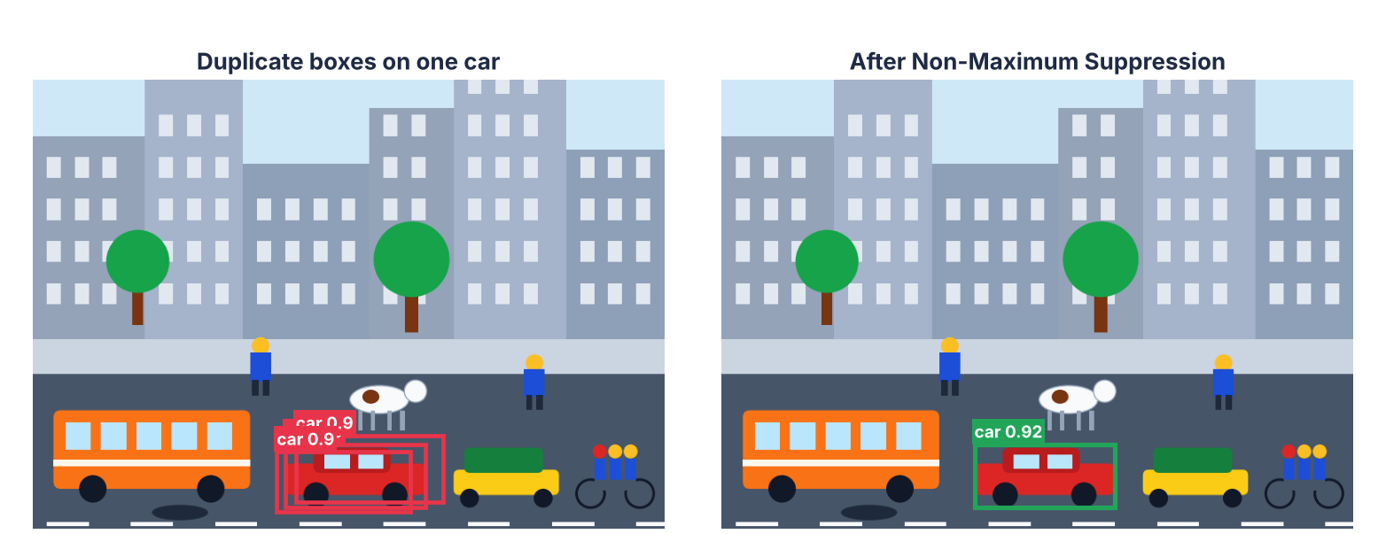
Anchor-Based Detection: Duplicate Predictions and Non-Maximum Suppression
IoU threshold: too strict or too relaxed?

Slide 44
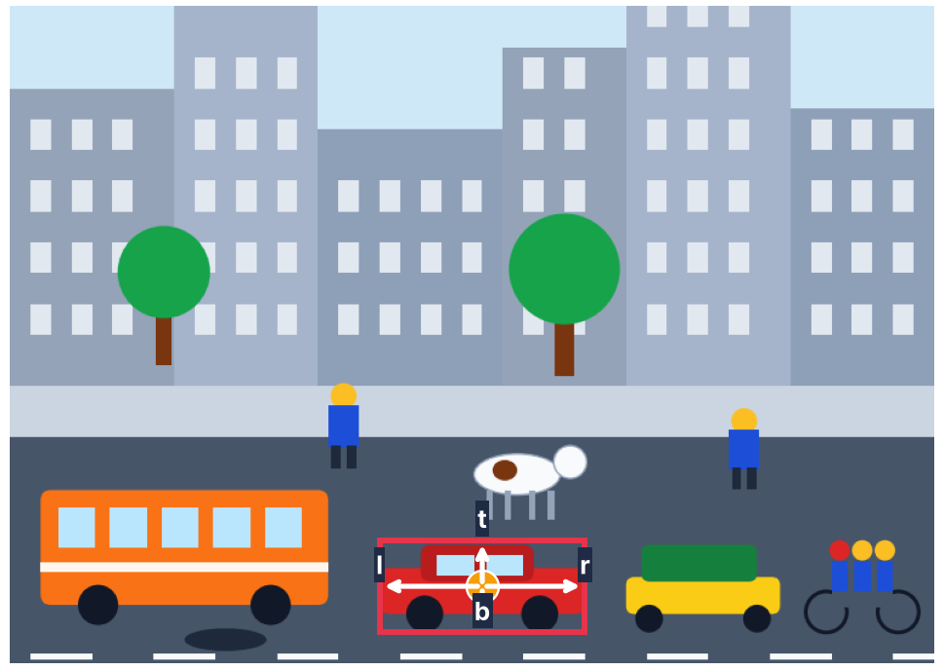
Anchor-Free Detection: Moving Beyond Predefined Boxes
Predict from object centres
Fully Convolutional One-Stage detector: distance to four edges
Often still uses Non-Maximum Suppression

Slide 45
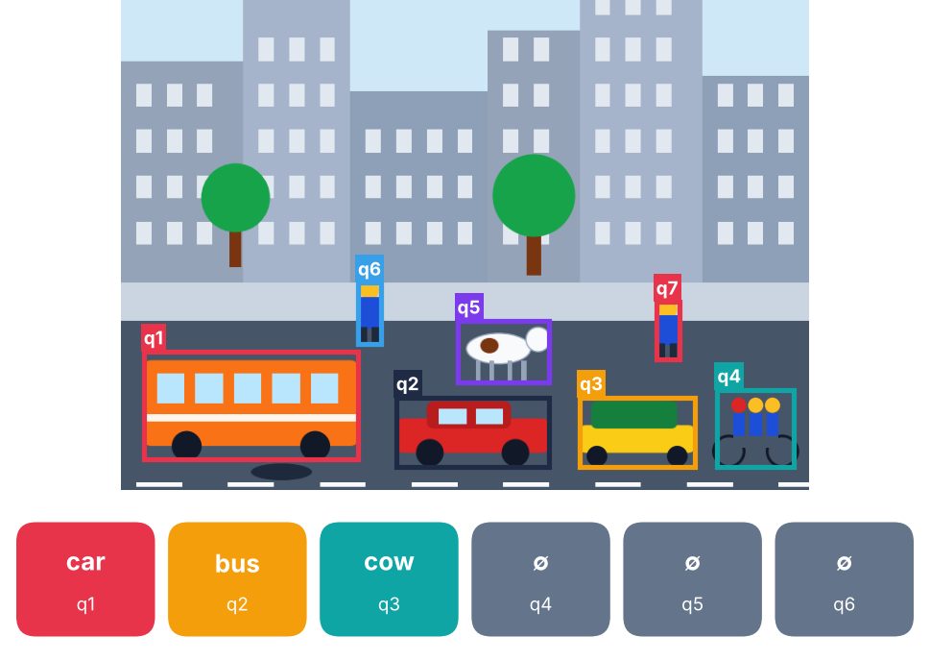
Transformer-Based Detection: The Set Prediction Approach
Fixed number of queries
Each slot: object or none
Detection Transformer = set prediction

Slide 46
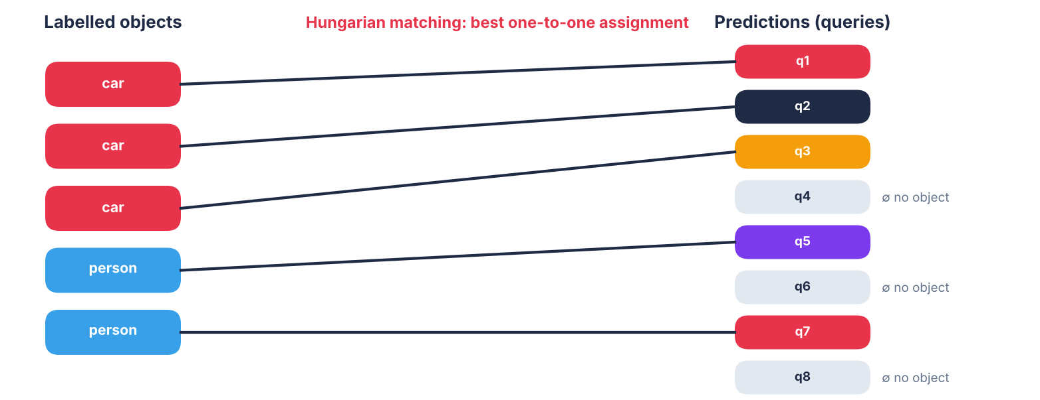
Box Matching: How Does Detection Transformer Learn?
Unmatched queries are trained as “no object”

Slide 47
Quick Check
What is Hungarian matching used for in Detection Transformer training?
A Removing duplicates with an IoU threshold
B One-to-one assignment of predictions to labelled objects
C Creating anchor boxes
D Resizing images

Slide 48
Answer
What is Hungarian matching used for in Detection Transformer training?
A Removing duplicates with an IoU threshold
✓ B One-to-one assignment of predictions to labelled objects
C Creating anchor boxes
D Resizing images
Why: Unmatched queries are trained as “no object”.

Slide 49
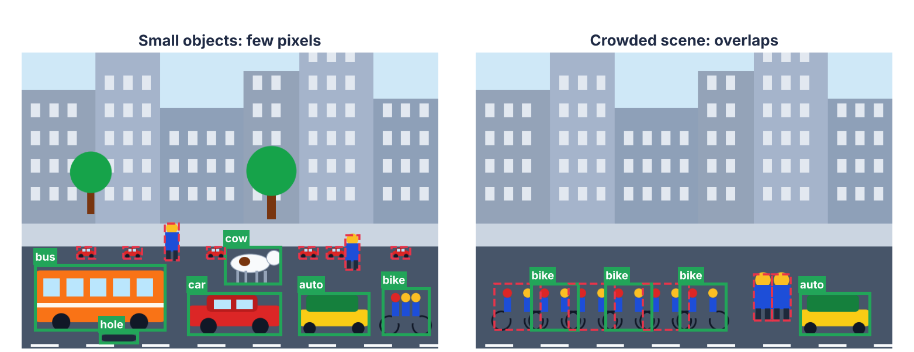
Small and Crowded Objects: Where Do Detectors Struggle?
Open directions: multi-scale learning, overlap handling

Slide 50
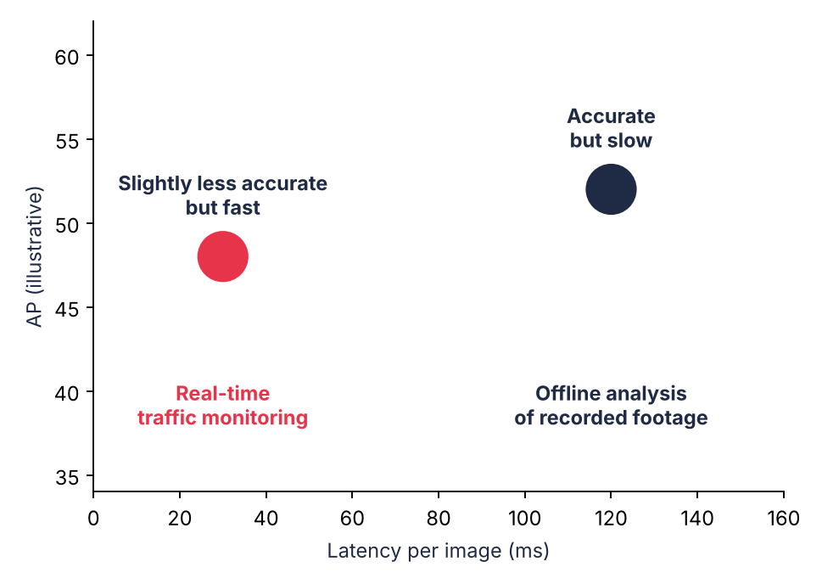
Accuracy versus Latency: Is a More Accurate Detector Always Better?
Accurate versus fast
Real-time versus offline
Evaluate in context

Slide 51
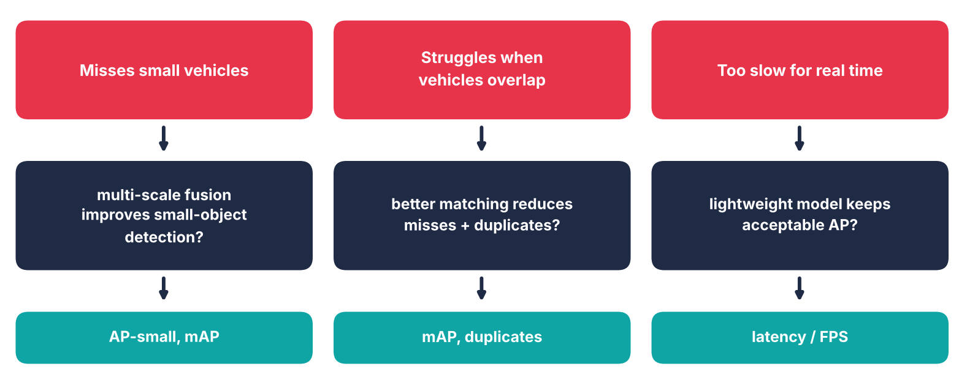
From Detection Limitations to Research Questions
Limitation → question → measure

Slide 52
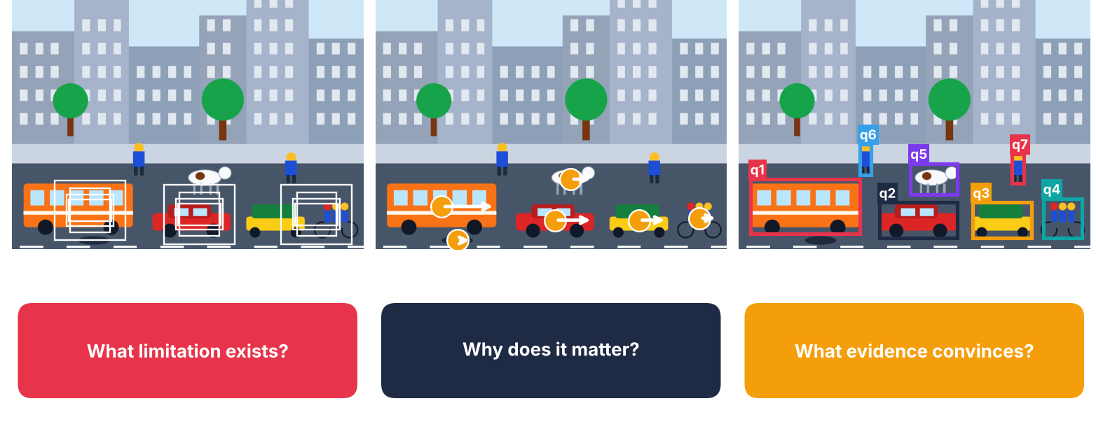
Choosing the Right Detector for a Research Study
Start with the problem, not the newest detector

Slide 53
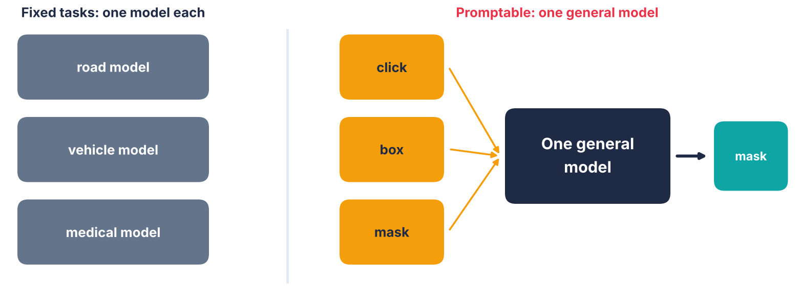
Segmentation Frontiers: From Fixed Tasks to Promptable Models
Prompt-based segmentation, for example Segment Anything Model

Slide 54
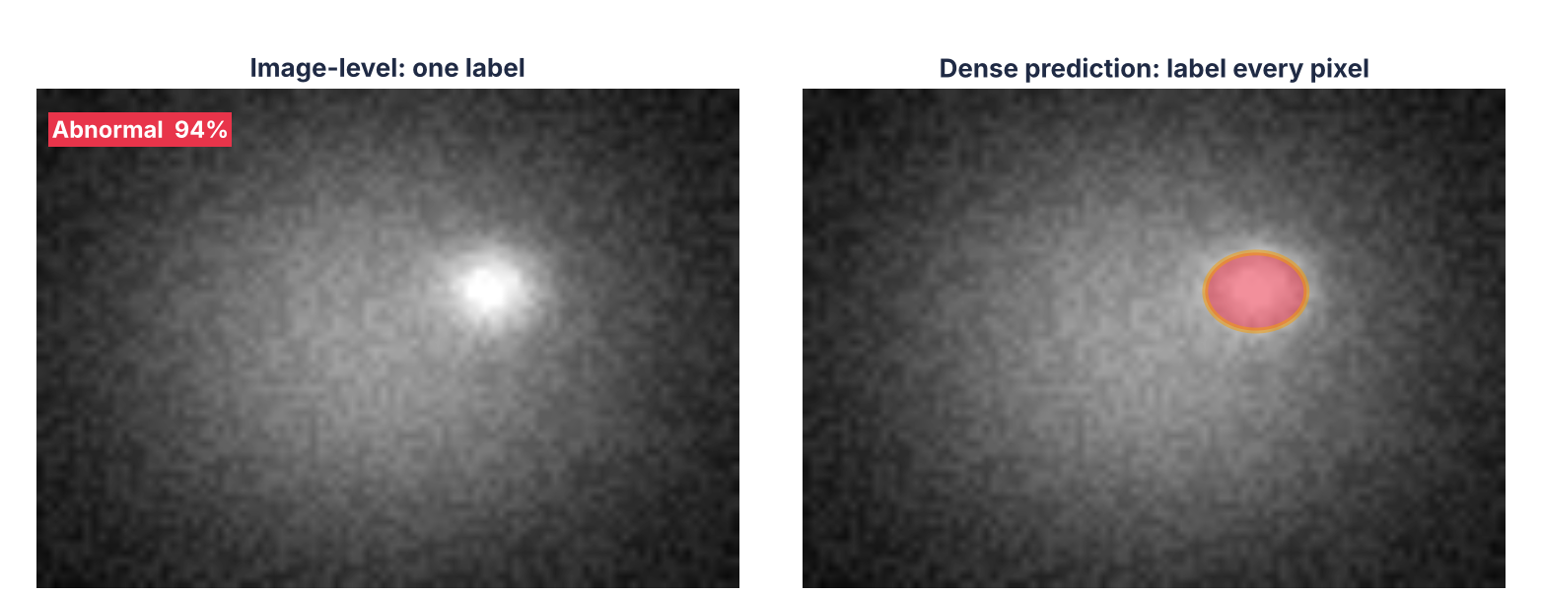
Dense Prediction: Understanding Every Pixel
Needs detailed spatial understanding

Slide 55
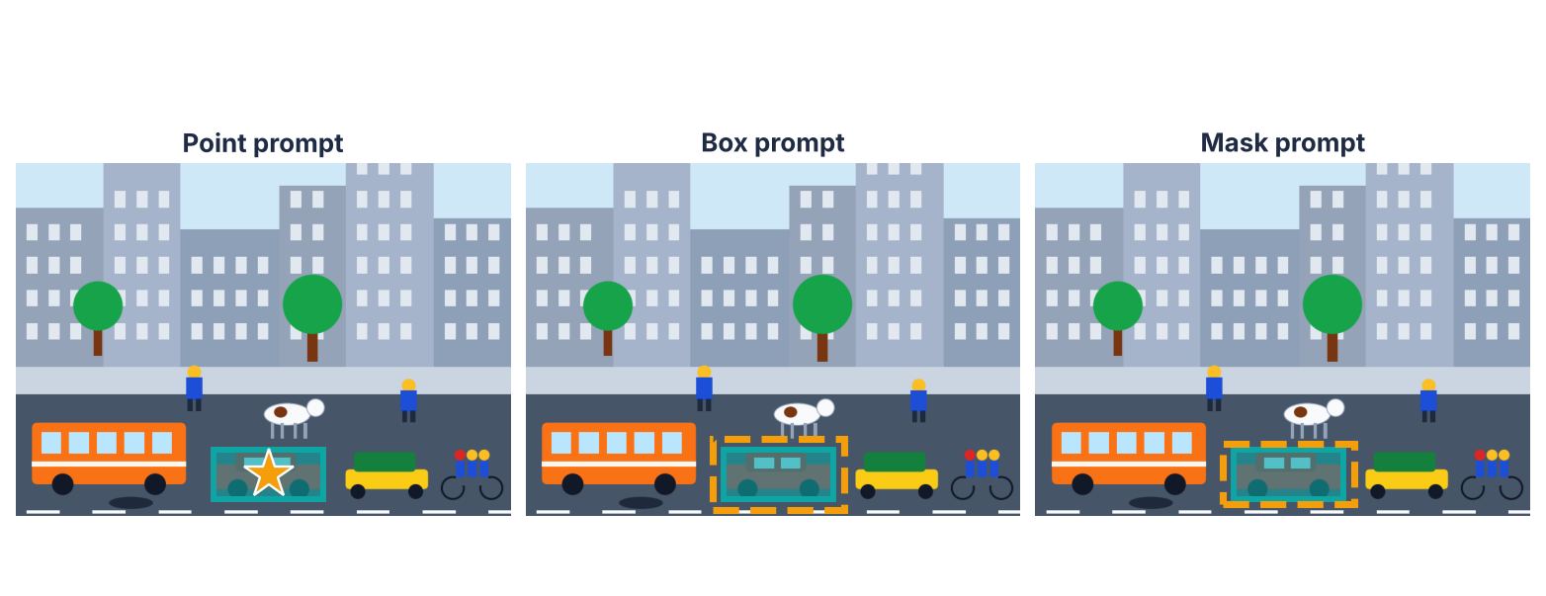
What Is Promptable Segmentation?
One general model · different prompts

Slide 56
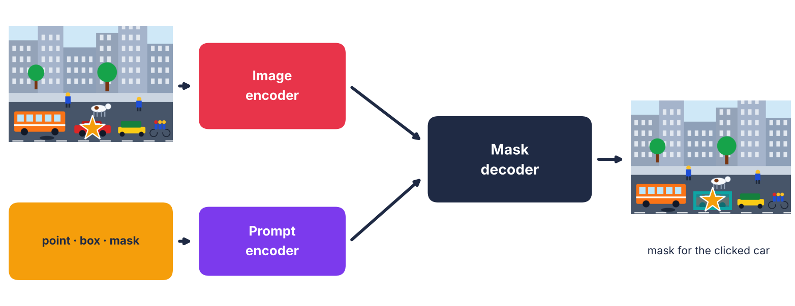
Segment Anything Model: How Does It Work?
Image encoder and prompt encoder and mask decoder

Slide 57
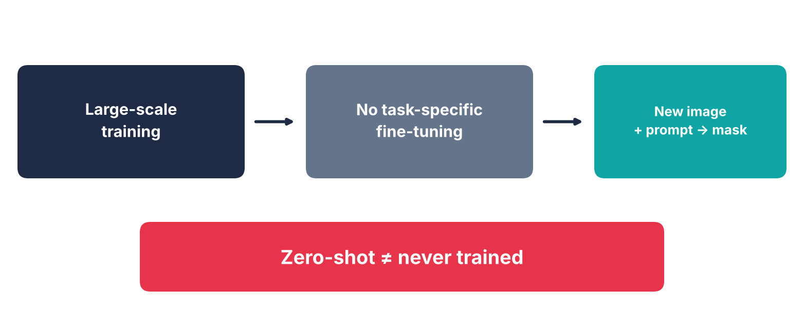
Zero-Shot Transfer: What Does It Mean?
Transfer without task-specific fine-tuning

Slide 58
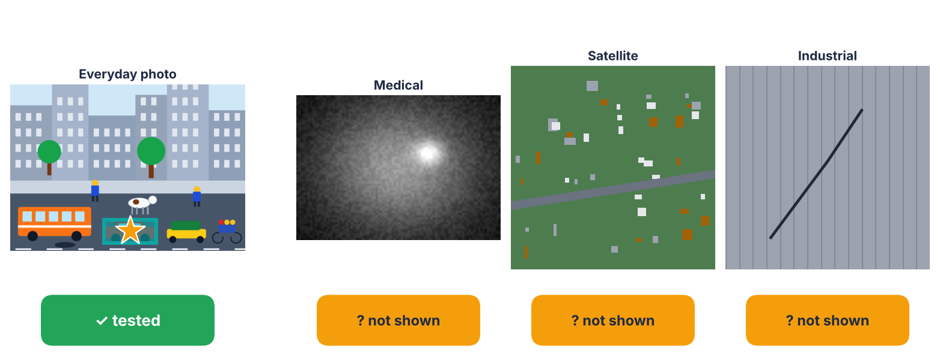
Zero-Shot Success: What Does It Prove?
Domain-specific evaluation before claiming reliability

Slide 59
Quick Check
Segment Anything Model segments a car in an unseen photo. What can we claim?
A It will work on medical and satellite images
B It worked under the tested image and prompt conditions
C It was never trained
D No further evaluation is needed

Slide 60
Answer
Segment Anything Model segments a car in an unseen photo. What can we claim?
A It will work on medical and satellite images
✓ B It worked under the tested image and prompt conditions
C It was never trained
D No further evaluation is needed
Why: Domain-specific evaluation is needed before claiming reliability.

Slide 61

Break 1 (10 minutes)

Slide 62
Live Demonstration: Same Images, Three tasks, Three failure modes
Code used: Google Colab

Slide 63
What We Will Do in the Next 45 Minutes
Part 1
Run three models on the same images
Live Demonstration
Part 2
Predict, reveal, classify failures
Live Demonstration
Part 3
Test metrics, thresholds and robustness
Evaluation

Slide 64

The Six-Image Set
clean · small · occluded · blurred · night rain · cluttered

Slide 65
The Setup: One Image Set, Three Models
from transformers import pipeline
imgs = ["clean.jpg","small.jpg","occluded.jpg",
"blurred.jpg","night_rain.jpg","cluttered.jpg"]
clf = pipeline("image-classification",
model="google/vit-base-patch16-224")
det = pipeline("object-detection",
model="facebook/detr-resnet-50")
Same images for every model
One Hugging Face pipeline each
No code to write today:
links are on the next slides
DETR: Detection Transformer

Slide 66

Task 1: Classifier
out = clf("clean.jpg", top_k=3)
for o in out:
print(o["label"], round(o["score"],2))
Output format (illustrative values):
minibus 0.41
minivan 0.22
passenger car 0.09
One label for the WHOLE image

Slide 67
Task 2: Detector
res = det("clean.jpg", threshold=0.7)
for r in res:
print(r["label"], round(r["score"],2), r["box"])
Output format (illustrative values):
bus 0.99 {box}
car 0.97 {box}
person 0.93 {box}
Class + box per object

Slide 68
Task 3: Promptable Segmentation (SAM)
from transformers import SamModel, SamProcessor
m = SamModel.from_pretrained("facebook/sam-vit-base")
p = SamProcessor.from_pretrained("facebook/sam-vit-base")
inp = p(img, input_points=[[[450,600]]],
return_tensors="pt")
out = m(**inp)
masks = p.image_processor.post_process_masks(
out.pred_masks, inp["original_sizes"],
inp["reshaped_input_sizes"])
Output: 3 candidate masks
+ iou_scores per mask
A click is the prompt.
No class label returned.

Slide 69
See Real Outputs: Open the Hugging Face Space
Segment Anything 2 · Hugging Face Space ↗
Click to open on huggingface.co
Meta Segment Anything · Live demo ↗
Click to open on segment-anything.com
DETR · Hugging Face documentation ↗
Click to open on huggingface.co

Slide 70
See Real Outputs: Open the Colab Notebooks
SAM 2 image predictor · Colab ↗
Click to open on colab.research.google.com
SAM automatic masks · Colab ↗
Click to open on colab.research.google.com
SAM 2 with Roboflow · Colab ↗
Click to open on colab.research.google.com

Slide 71
Our Method: Predict, Reveal, Classify
Data coverage
Was this in the training data?
Model behaviour
Does the architecture fail here?
Annotation quality
Are the labels themselves doubtful?
Evaluation choice
Does the metric hide or exaggerate it?

Slide 72

Predict: Small Objects
PREDICT
1 Classifier?
2 Detector?
3 SAM?
Type it in chat

Slide 73
Reveal: Small Objects
Classifier
Still says 'minibus'
Detector
Truck missed or low score
SAM
Mask only if clicked
FAILURE TYPE: DATA COVERAGE
Cause: Tiny objects are rarer in training

Slide 74

Predict: Occlusion
PREDICT
1 Classifier?
2 Detector?
3 SAM?
Type it in chat

Slide 75
Reveal: Occlusion
Classifier
Label may change
Detector
Box shrinks or splits
SAM
Mask may skip hidden part
FAILURE TYPE: MODEL BEHAVIOUR
Cause: Partial view

Slide 76

Predict: Blur
PREDICT
1 Classifier?
2 Detector?
3 SAM?
Type it in chat

Slide 77
Reveal: Blur
Classifier
Lower confidence
Detector
Boxes loose, scores drop
SAM
Mask edges ragged
FAILURE TYPE: ANNOTATION + EVALUATION
Cause: Edges ambiguous

Slide 78

Predict: Domain Shift: Night and Rain
PREDICT
1 Classifier?
2 Detector?
3 SAM?
Type it in chat

Slide 79
Reveal: Domain Shift: Night and Rain
Classifier
Label changes, e.g. 'street sign'
Detector
Fewer detections
SAM
Reasonable masks
FAILURE TYPE: DATA COVERAGE
Cause: Trained mostly on day

Slide 80
Quick Check
A detector misses a tiny pothole it never saw in training. Primary cause?
A Evaluation choice
B Data coverage
C Annotation quality
D Loss function

Slide 81
Answer
A detector misses a tiny pothole it never saw in training. Primary cause?
A Evaluation choice
✓ B Data coverage
C Annotation quality
D Loss function

Slide 82
Summary: Four Failures, Four Causes
Small
Detector misses
Data coverage
Occluded
Box splits
Model behaviour
Blurred
Loose boxes
Annotation + metric
Night rain
Scores fall
Data coverage

Slide 83
Zero-Shot Success: What It Does and Does Not Show
Shows
Transfer on the images and prompts tested
Does not show
Readiness for medical, satellite or night traffic
Needed
Domain-specific evaluation before any claim

Slide 84
Evaluation That Holds Up: Match Metric to Task
Classification
Top-k accuracy, F1
Hides: rare classes
Detection
IoU, AP
Hides: loose boxes at IoU 0.5
Segmentation
mIoU (Mean Intersection over Union), Dice
Hides: small objects

Slide 85
Classification: Accuracy Can Hide a Rare Class
y = [0]*6 + [1]*2 + [2] + [3] # 3 = rare cow
p = [0]*6 + [1]*2 + [0] + [0]
acc = sum(a==b for a,b in zip(y,p)) / len(y)
f1s = []
for c in range(4):
tp = sum(a==c and b==c for a,b in zip(y,p))
fp = sum(a!=c and b==c for a,b in zip(y,p))
fn = sum(a==c and b!=c for a,b in zip(y,p))
f1s.append(2*tp/(2*tp+fp+fn) if tp else 0.0)
print("accuracy:", acc)
print("per-class F1:", [round(f,2) for f in f1s])
print("macro-F1:", round(sum(f1s)/4,2))
REAL OUTPUT
accuracy: 0.8
per-class F1: [0.86, 1.0, 0.0, 0.0]
macro-F1: 0.46

Slide 86

Same Result as a Chart
Accuracy 0.80 · Macro-F1 0.46

Slide 87
IoU: Same Detections, Stricter Thresholds
import numpy as np
def iou(a, b): # boxes [x1,y1,x2,y2]
x1,y1 = max(a[0],b[0]), max(a[1],b[1])
x2,y2 = min(a[2],b[2]), min(a[3],b[3])
inter = max(0,x2-x1) * max(0,y2-y1)
ua = ((a[2]-a[0])*(a[3]-a[1])
+ (b[2]-b[0])*(b[3]-b[1]) - inter)
return inter / ua
gt = [[100,100,200,200], [300,120,380,200],
[50,300,120,360], [400,300,430,330]]
pred = [[105,102,205,204], [310,130,392,214],
[62,312,134,372], [415,315,447,349]]
ious = [iou(g,p) for g,p in zip(gt,pred)]
for t in (0.5,0.75,0.9):
n = sum(i >= t for i in ious)
print(f"IoU>={t}: {n}/4 correct")
print("IoUs:", [round(i,2) for i in ious])
REAL OUTPUT
IoU>=0.5: 2/4 correct
IoU>=0.75: 1/4 correct
IoU>=0.9: 0/4 correct
IoUs: [0.85, 0.58, 0.49, 0.13]

Slide 88

What the Overlap Looks Like
Small boxes lose overlap fastest

Slide 89

AP Falls as the Threshold Tightens
Same 4 detections
Correct count drops as IoU rises
Report AP at 0.5 AND stricter (for example 0.5:0.95)

Slide 90
See Real AP at Several IoU Thresholds: DETR Notebook
DETR inference and COCO evaluation · GitHub ↗
Click to open on github.com
DETR · Hugging Face documentation ↗
Click to open on huggingface.co

Slide 91
Quick Check
A paper reports AP@0.5 only. What is missing?
A Training curve
B Stricter IoU and per-size AP
C More layers
D A newer logo

Slide 92
Answer
A paper reports AP@0.5 only. What is missing?
A Training curve
✓ B Stricter IoU and per-size AP
C More layers
D A newer logo

Slide 93
Segmentation: Pixel Accuracy Can Mislead
import numpy as np
gt = np.zeros((100,100), bool)
gt[40:60, 40:60] = True # small object
pr = np.zeros((100,100), bool)
pr[20:40, 20:40] = True # mask misses it
inter = (gt & pr).sum()
union = (gt | pr).sum()
print("pixel acc:", round((gt==pr).mean(),3))
print("IoU :", round(inter/union,3))
print("Dice :", round(2*inter/(gt.sum()+pr.sum()),3))
REAL OUTPUT
pixel acc: 0.92
IoU : 0.0
Dice : 0.0

Slide 94

What the Masks Look Like
Background hides the miss

Slide 95
Annotation Quality: The Benchmark Is Part of the Method
Label noise
Wrong or shifted boxes
Train-test overlap
Near-duplicate frames inflate scores
Saturation
Benchmark too easy to separate models
Ask
What would this mean on another camera?

Slide 96
Distribution Shift: Report the Drop
Day
Baseline score
Rain
Report the drop
Night
Report the drop
New camera
Report the drop

Slide 97
Class-Wise Results and Repeated Runs
Class-wise
Cars good, cows and potholes weak
Repeated runs
Same setup, 3-5 seeds
Report
Mean and spread, not best run

Slide 98
Latency: Accuracy Is Not the Whole Story
Cloud GPU
Accuracy first
Camera on a pole
Latency first
Rule
Same hardware, same image size, report both

Slide 99
Is the Gain Robust? Five Checks
Annotation quality
Label noise, train-test overlap
Distribution shift
Night, rain, new camera
Class-wise results
Rare classes, small objects
Repeated runs
Mean and spread over seeds
Latency
Same hardware, same size

Slide 100
Resources: Existing Notebooks and Spaces
Segment Anything 2 · Hugging Face Space ↗
Click to open on huggingface.co
SAM 2 image predictor · Colab ↗
Click to open on colab.research.google.com
SAM automatic masks · Colab ↗
Click to open on colab.research.google.com
DETR notebooks · GitHub ↗
Click to open on github.com. Also, can try on Huggingface Space
SAM 2 with Roboflow · Colab ↗
Click to open on colab.research.google.com

Slide 101
Bridge to the Design Lab
Failure → cause → metric → test
Your Study Card needs:
• one robustness check
• one metric that cannot hide the failure
Chat: which failure will you study?

Slide 102
Break 2 (5 minutes)

Slide 103
Frontier Scan and Research Lab

Slide 104

From Models to Open Research Questions
Every limitation is an opportunity

Slide 105

Direction 1: Supervision Efficiency
Test at several label budgets

Slide 106

Direction 2: Open-Vocabulary Learning
Seeing it ≠ locating it

Slide 107

Direction 3: Efficient Edge Models
Report accuracy and speed together

Slide 108

Direction 4: Domain-Specific Vision
Everyday images ≠ your domain

Slide 109

Direction 5: Robustness Under Shift
Report the drop, not just the best score

Slide 110

Five Directions, One Recipe
Same recipe, every direction

Slide 111
Quick Check
A team says its compressed detector is 3× faster. What else must it report?
A Training loss only
B Accuracy + latency, same hardware
C Number of layers
D A newer backbone

Slide 112
Answer
A team says its compressed detector is 3× faster. What else must it report?
A Training loss only
✓ B Accuracy + latency, same hardware
C Number of layers
D A newer backbone
Why: Speed claims need accuracy and latency.

Slide 113

Design Lab: You Are the Researchers
Set up · Build · Review

Slide 114

The Study Card: Nine Fields
Claim · Evidence · Stress-test

Slide 115

Worked Example: Junction Study Card
One model answer to react to

Slide 116

Choose Your Task and Limitation
Start from the failure, not the model name

Slide 117

Build 1: Write a Testable Hypothesis
If nothing can prove it wrong, it is not testable

Slide 118

Build 2: Dataset and Labels
The benchmark is part of your method

Slide 119
Quick Check
Which hypothesis is testable?
A Our model will be better
B Deep learning helps cameras
C Fusion lifts AP-small by 3+ points
D The demo will look great

Slide 120
Answer
Which hypothesis is testable?
A Our model will be better
B Deep learning helps cameras
✓ C Fusion lifts AP-small by 3+ points
D The demo will look great
Why: It names a change, metric, size, baseline.

Slide 121

Build 3: Baseline and Change
Change one thing at a time

Slide 122

Build 4: Primary Metric
Every metric can hide a failure

Slide 123

Build 5: Robustness and Ablation
One hard case · one part removed

Slide 124

Build 6: Compute and Main Risk
Feasibility decides what you can test

Slide 125
Quick Check
640 px / 100 epochs beats 320 px / 20 epochs. What is wrong?
A Settings differ, so gain is unclear
B Baseline is too accurate
C It needs more classes
D Nothing is wrong

Slide 126
Answer
640 px / 100 epochs beats 320 px / 20 epochs. What is wrong?
✓ A Settings differ, so gain is unclear
B Baseline is too accurate
C It needs more classes
D Nothing is wrong
Why: Match settings before crediting the model.

Slide 127

Self-Check: The Golden Thread
Does one thread connect every field?

Slide 128

Finish Line: Add Your Falsifier
Say what would prove you wrong

Slide 129

Peer Review: Swap and Question
Be a kind but sharp reviewer

Slide 130

Giving Feedback That Helps
One strength, one gap, one fix

Slide 131
Quick Check
Which statement is a falsifier?
A Fails if gain is under 3 points at night
B We will report our best run
C We will tune until it works
D We expect higher accuracy

Slide 132
Answer
Which statement is a falsifier?
✓ A Fails if gain is under 3 points at night
B We will report our best run
C We will tune until it works
D We expect higher accuracy
Why: A falsifier names metric, threshold, test set.

Slide 133

Round 2: Revise the Weakest Field
Fix one field well

Slide 134

Share-Out: What Changed?
One sentence from each pair in chat

Slide 135

Research Roadmap: Next Steps
A Study Card is a plan for evidence

Slide 136

Evidence Gate: Go, Redo or Park
Parking is a decision, not a failure

Slide 137
Quick Check
Vague hypothesis, unfair baseline, exciting topic. Best decision?
A Proceed: it is exciting
B Park it forever
C Redesign before spending compute
D Skip the baseline

Slide 138
Answer
Vague hypothesis, unfair baseline, exciting topic. Best decision?
A Proceed: it is exciting
B Park it forever
✓ C Redesign before spending compute
D Skip the baseline
Why: Good problem, weak design: redesign first.

Slide 139

After the Session: Your Research Brief
Your research brief
Pick one task
Next: literature search

Slide 140

Open Questions to Carry Forward

Slide 141
Thank you

